Slide 1
Distributed SWI-Prolog Development
Anne Ogborn
Notes:
Welcome to Distributed SWI-Prolog Development. I'm Anne Ogborn. Feel free to ask questions at any time.

Slide 2


Pengines
Torbjorn Lager
University of Gothenborg
Jan Wielemaker
Free Univ. of the Netherlands
Notes:
Over the last 9 months an intersting ecosystem has built up in the SWI-Prolog environment, based around
a library called pengines, written by Torbjorn lager of the univ of Gothenborg and Jan Wielemaker at the Free University of the Netherlands.
I'm going to show you that library, starting with some of what motivated it, and then showing you the API.
After that we'll take a brief look at the rest of the ecosystem.
This is an early look at a very new system. While the core is pretty solid, many of the peripheral pieces are just
now being made, so it's an interesting time for us.

Slide 3
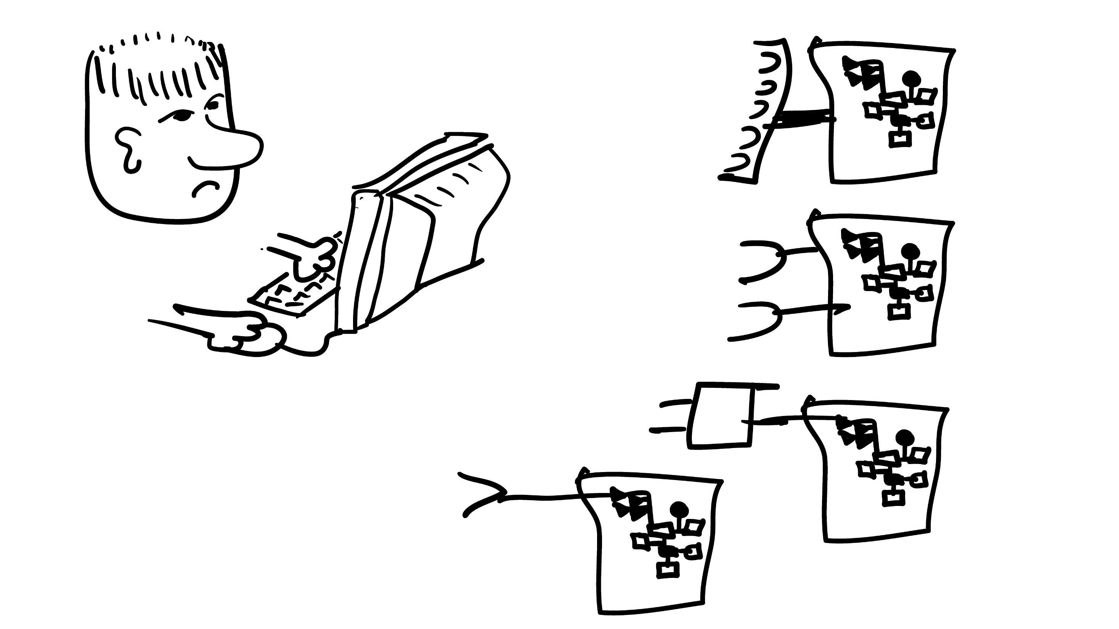
Notes:
Suppose you want to make a federated query of data from many servers. By a federated query I mean we want to do joins on tables that are on different servers. The really awful way to do this is to have a web API on each server, get a superset of the data you actually need from each server, and then do the join locally. This is going to be painful. But it's what happens now.
How many of you here have done this?
A better way would be to have shell access to each server. You could run out your data locally, ftp it out, and at least minimize the pain. But that still doesn't federate the query.
So, one option would be to automate the accesses - then you could ping pong back and forth, getting small data items and do the join as you go.
Hey - that, it turns out, is the same SLD resolution algorithm Prolog uses.

Slide 4
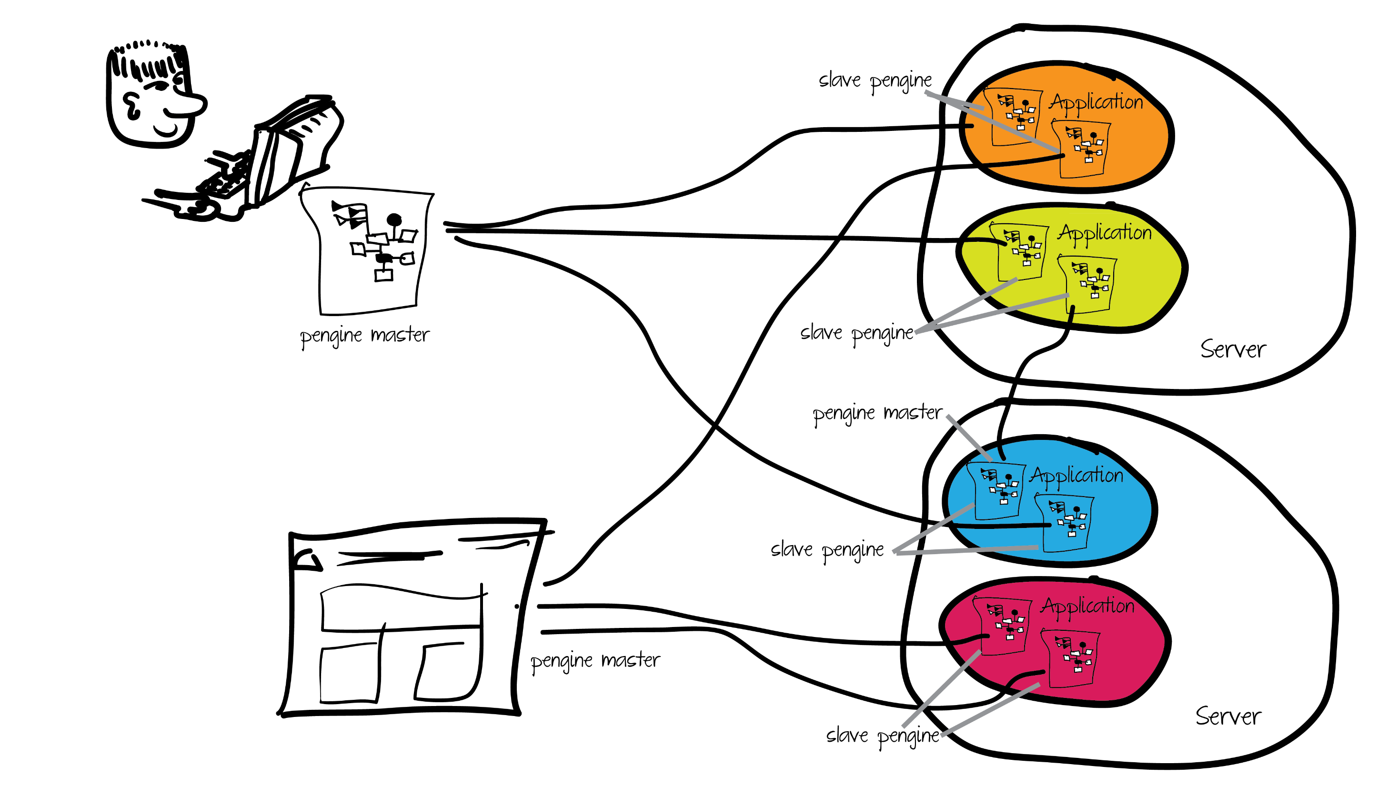
Notes:
So, here's a sample universe with some pengines.
There are 3 roles - applications, masters, and slaves.
Applications are containers that hold pengines. Each application has an URI.
Masters request pengines from applications.
Slaves are the actual pengines.
The slave is a lightweight VM, similar to an Erlang process, that provides the master with a Prolog interactor,
just like if the programmer had SSH'ed into the server manually.

Slide 5
Universe with pengines, with part highlighted
Notes:
So, the master asks the application to create a pengine.
The application returns an ID. Since the master alone knows the ID, only it can control the pengine.
The master can be a remote server, another process on the same server, the same VM that is running the application, or a web page.
People clear about the architecture?

Slide 6
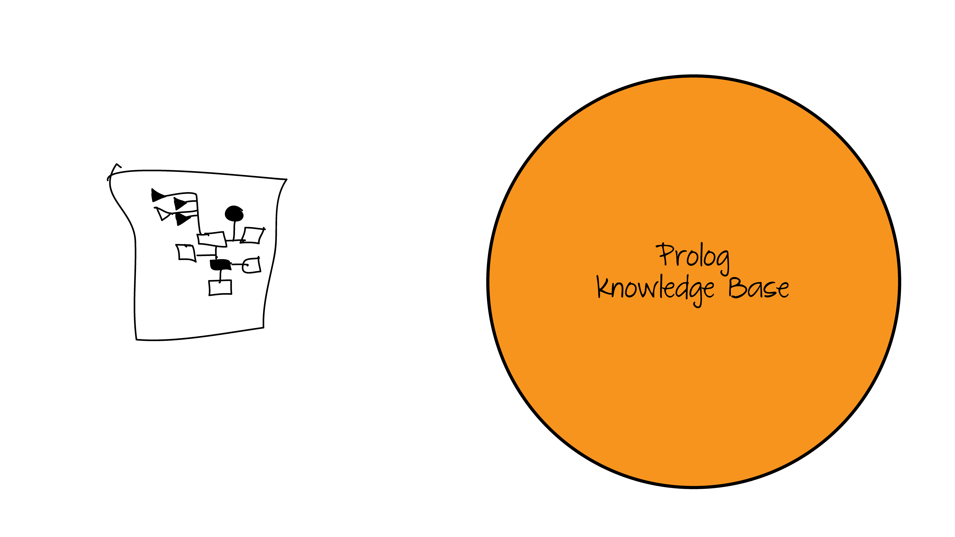
Notes:
Here's the server's total knowledgebase

Slide 7
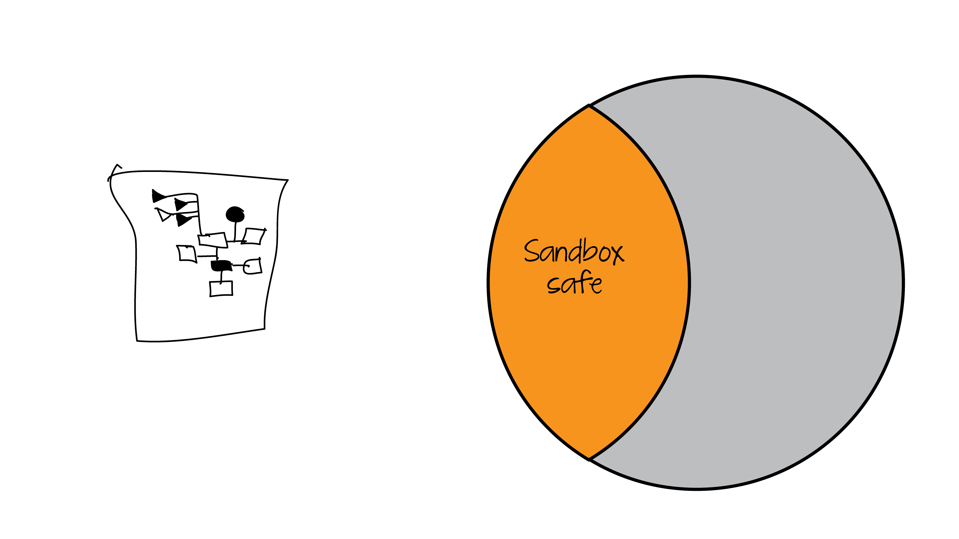
Notes:
Of course we shouldn't expose all of it. We don't want the pengine to be able to call shell, for example.
The default application is sandbox. Sandbox only exposes those items that it considers safe, and analyzes code before running it to make sure it too is safe.

Slide 8

Notes:
Typically one creates an application by importing a module into the sandbox. So we have the union of the sandbox and the application space

Slide 9

Notes:
The application, however, also needs to be safe code, so unsafe code is removed.

Slide 10

Notes:
However the container can explicitly mark individual predicates as safe. Obviously if you are going to allow users to alter a database, somewhere there has to be a hole to get to it.

Slide 11
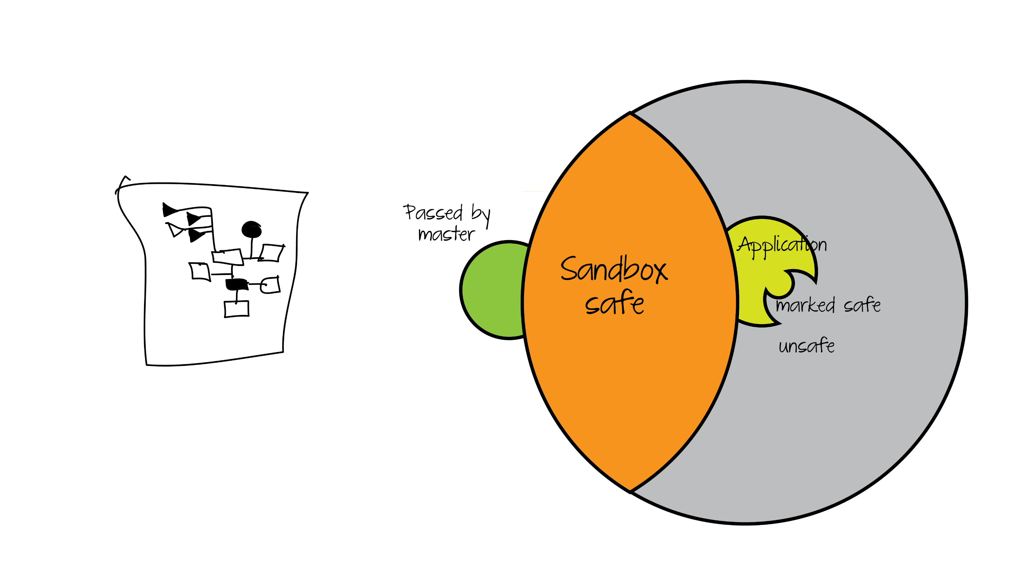
Notes:
When you make a pengine you can supply code to be added. This is great for holding state on the server, customizing queries by ID's and such, and making precompiled subqueries. This code is unique to this slave.

Slide 12
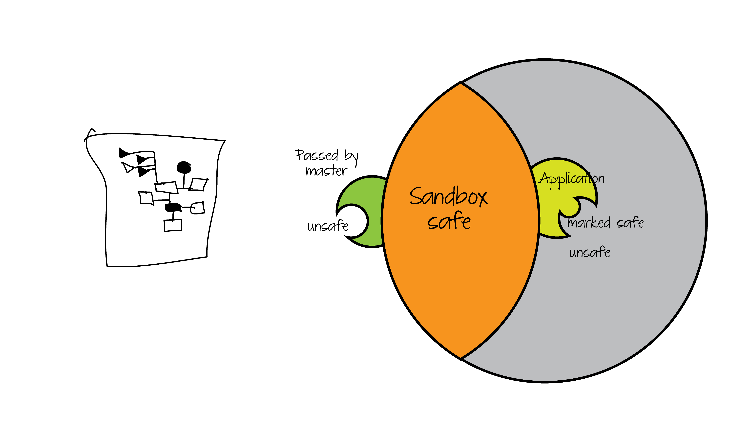
Notes:
Of course letting someone hand us a shell call would be unsafe, so we do the same code analysis on the code passed by the master.

Slide 13
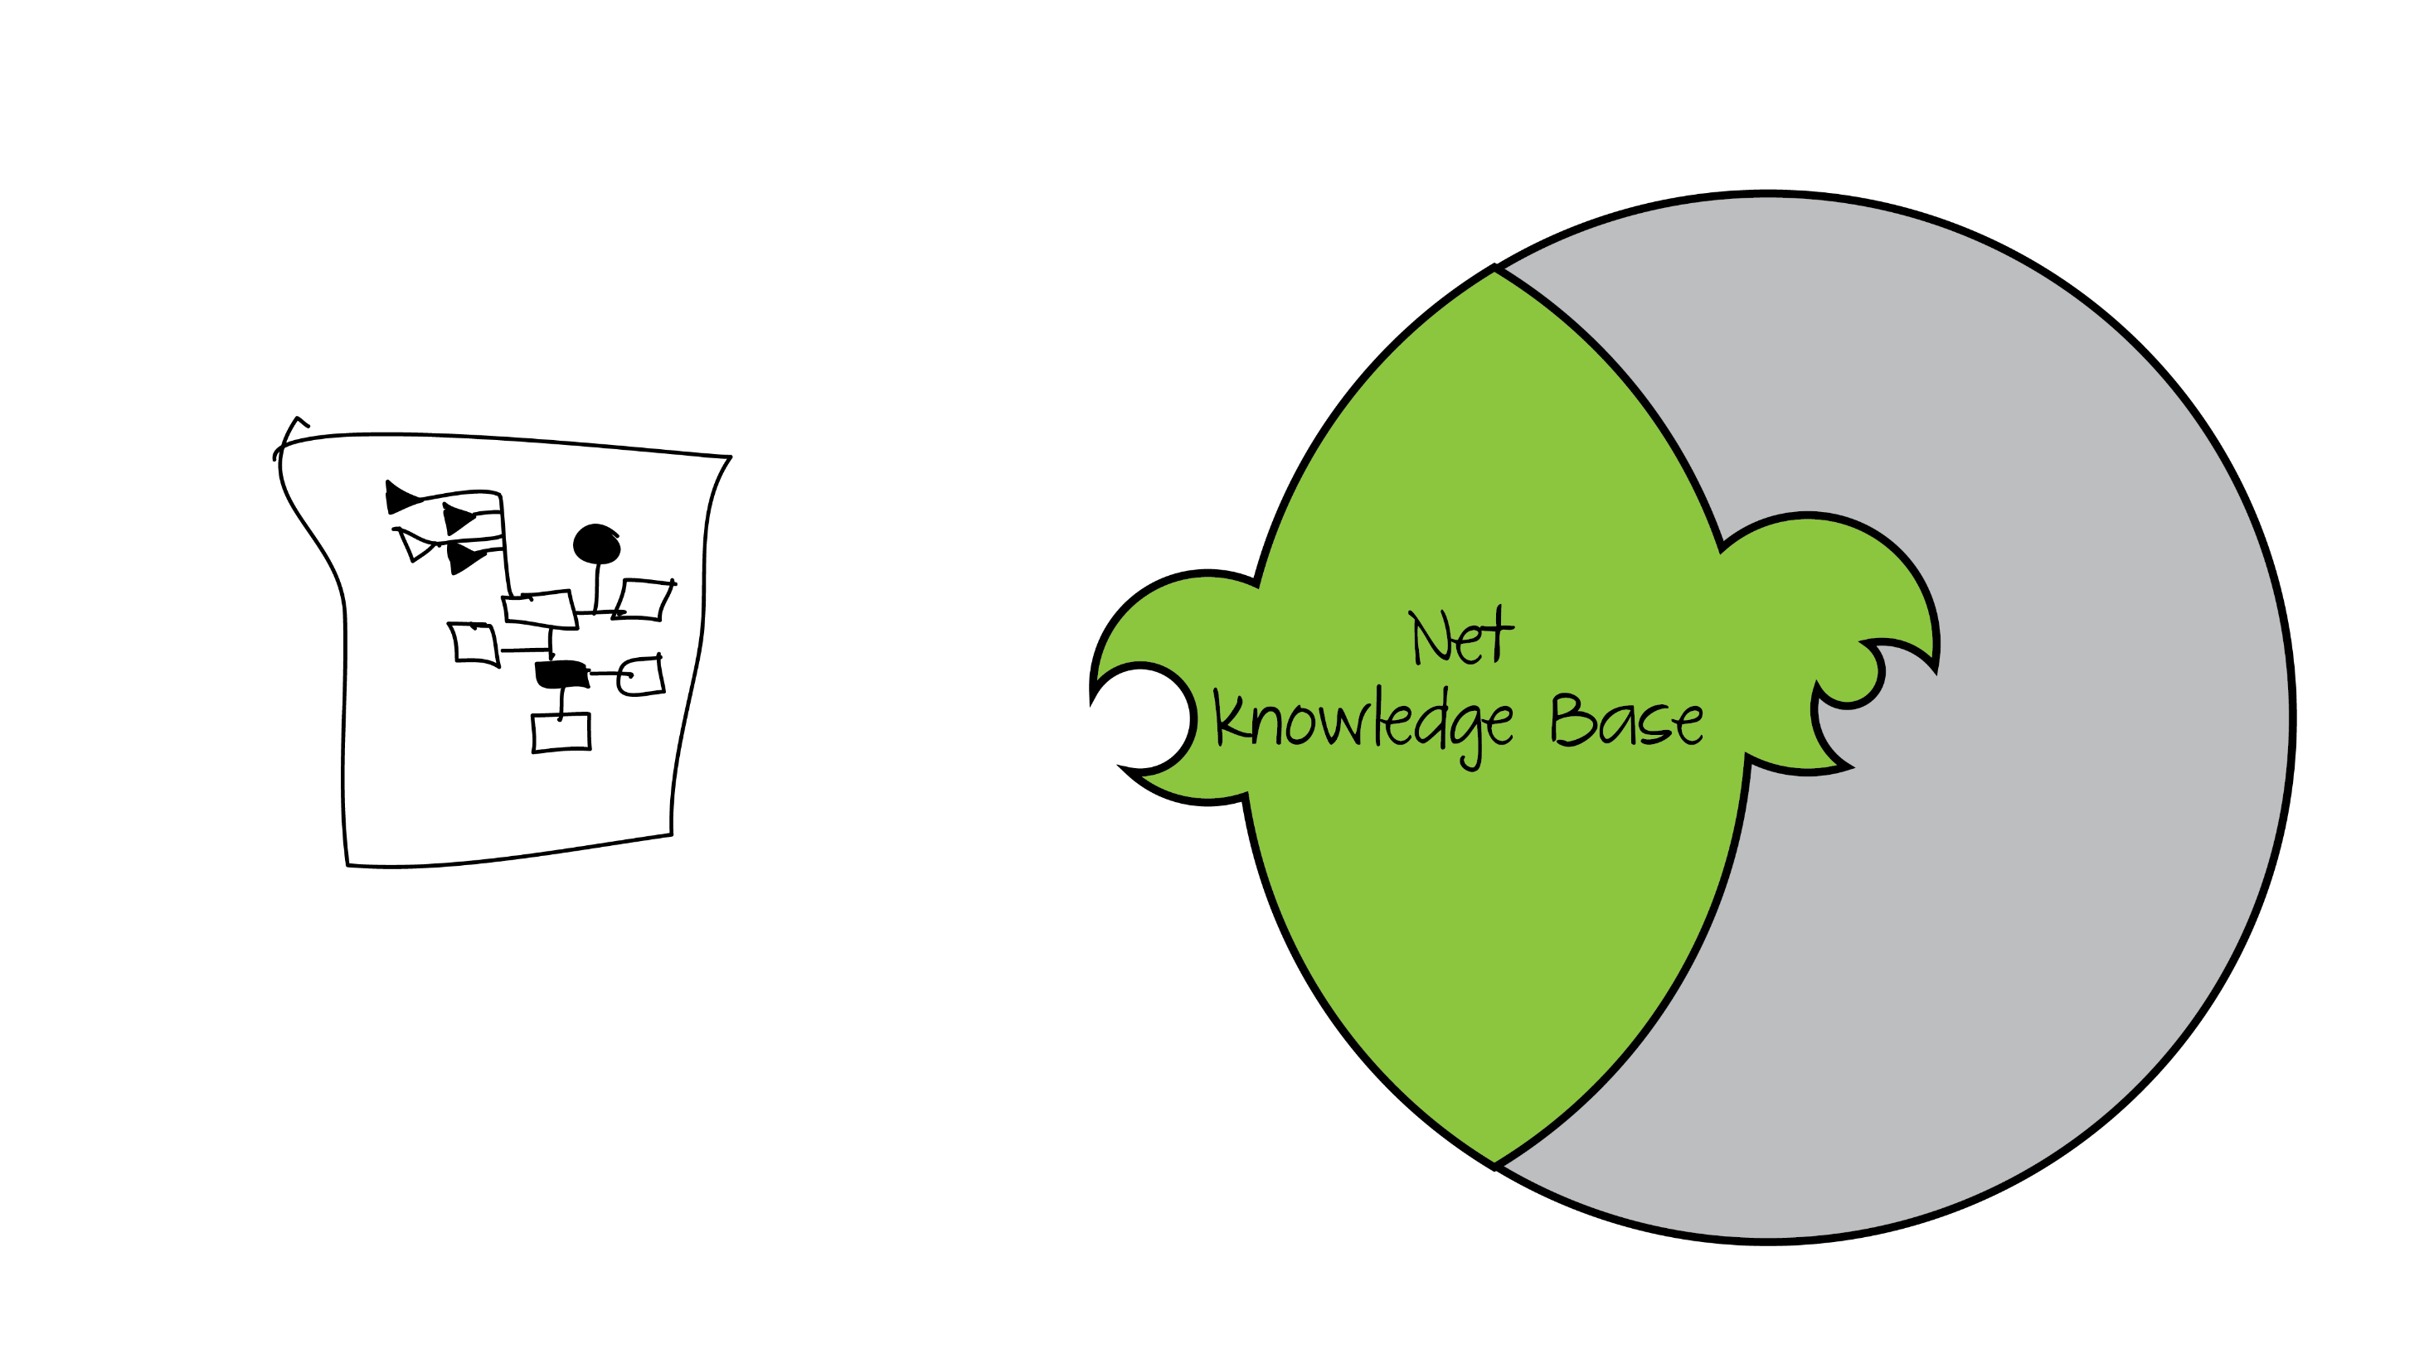
Notes:
So this is the net knowledge base we query against.

Slide 14
client.pl
pengine_demo(Port) :-
format(atom(URL), 'http://localhost:~d', [Port]),
pengine_create(
[ server(URL),
src_text("
q(X) :- p(X).
p(a). p(b). p(c).
")
]),
pengine_event_loop(handle, []).
handle(create(ID, _)) :-
pengine_ask(ID, q(_X), []).
handle(success(ID, X, false)) :- !,
writeln(X),
pengine_destroy(ID).
handle(success(ID, X, true)) :-
writeln(X),
pengine_next(ID, []).
Notes:
Once the pengine is created, the master can then make normal, nondeterministic Prolog queries.
Here we have some client code. Notice the pengine_event_loop and closure..

Slide 15
Other ways to query
IO
pengine_ask, pengine_next
pengine_rpc
pengine_input(+prompt, -term)
pengine_output(+term)
Notes:
If you prefer to own the loop, you can synchronously call pengine_ask and pengine_next.
You'll still get responses in events
If you want to retain the same nondeterministic behavior as the local call, you can use pengine_rpc

Slide 16
Notes:
Lets try this.
Here we have a shell that lets us enter arbitrary code on the left, make a query here, and execute the query on the server.
This application is called SWISH, it's one of the central pieces of the pengines toolkit.
DEMO SIMPLE PENGINE QUERY IN SWISH.
Notice that we're submitting Prolog from Javascript here. We've learned that using pengines can make doing ajax type web development a lot simpler.
Questions?

Slide 17
Notes:
You'll remember that we imported our application code into the sandbox.
Lets see how to do that.

Slide 18
main.pl
my_apis.pl
:- use_module(library(pengines)).
:- use_module(library(sandbox)).
:- use_module(pengine_sandbox:my_apis).
:- module(my_apis, [my_public/1]).
:- use_module(library(dcg/basics)).
my_public(X) :-
dont_say_walrus(X),
debug(pengine_example, 'my_public says ~w', [X]).
dont_say_walrus(X) :-
atom_codes(X, XC),
phrase(walrus, XC),
!,fail.
dont_say_walrus(_).
walrus --> string(_) , "walrus", string(_).

Slide 19
main.pl
my_apis.pl
:- use_module(library(pengines)).
:- use_module(library(sandbox)).
:- use_module(pengine_sandbox:my_apis).
:- module(my_apis, [my_public/1, my_unsafe/1]).
:- use_module(library(dcg/basics)).
my_public(X) :-
dont_say_walrus(X),
debug(pengine_example, 'my_public says ~w', [X]).
my_unsafe(X) :-
atom_length(X, Len),
Len < 25,
open('foo.txt', write, Stream),
format(Stream, 'Hello Out There ~w~n', [X]),
close(Stream).
:- multifile sandbox:safe_primitive/1.
sandbox:safe_primitive(my_apis:my_unsafe(_)).
Notes:
Now, if we want to use unsafe predicates, adding them is fairly straightforward.
We just export the unsafe predicate, and then define a new clause for sandbox:safe_primitive that unifies with our call.
Notice that this means we can make an arbitrary test for what's safe, we're not restricted to either allowing unrestricted access to a predicate or forbidding it.

Slide 20
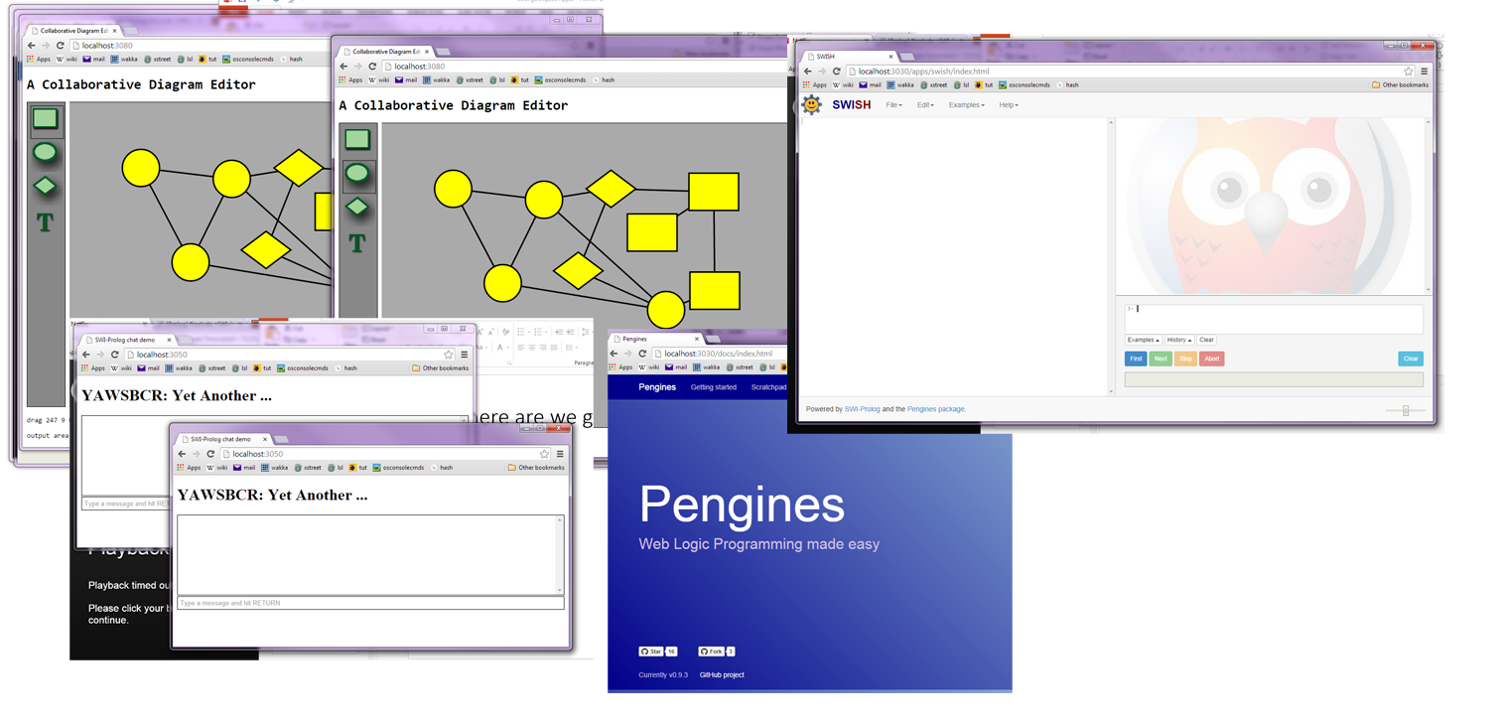
Where are we going?
Notes:
We're building up an ecosystem for
building distributed systems around pengines, websocket support, and a tool, hub.pl, for building collaborative applications.
We've made a few projects with that already. There's a whiteboard, a chat room, shared code editing, and other collaborative applications are coming quickly. There's already a commercial user - we have a hospital that is building a distributed system for scheduling hospital resources like rooms, operating theaters, and so on.
I've been having a lot of fun with the collaborative application system. It makes building a shared environment fun and easy.

Slide 21
Notes:
We have SWISH, and are just completing refactoring it into pieces so it can be used as building blocks for online query systems.
Jan is working on a data browser system that he's still keeping under wraps.
Torbjorn's planning on building an online system to teach Prolog.
And I'm slated to build some expert system shells with interactive interfaces along with some students from Stanford this semester.
Over the next 12 to 15 months, we expect to slowly turn SWISH into an industrial strength IDE, and slowly supplant the existing pceEmacs based IDE for SWI-Prolog.

Slide 22
Where to Get It
Get the most recent devel version of SWI-Prolog. Some of this material is literally weeks old.
http://swi-prolog.org
http://swish.swi-prolog.org
INSERT GITHUB REPO
Useful paper for understanding the relationship between prolog and RDF http://cliopatria.swi-prolog.org/help/whitepaper.html
Notes:
Thanks, I hope you've enjoyed hearing about pengines, I've enjoyed telling you all about them.
Thanks to Torbjörn Lager and Jan Wielemaker, who tolerated many naive questions while I was working on this.
These slides are available on
Any questions?

Slide 23
STOP OLD SLIDES BELOW HERE

Slide 24
Where we're going
Notes:
This talk is as much about motivations for what we're doing as the nitty gritty of the APIs involved.
introduce pengine ecosystem
pengine architecture
Motivate pengines
SWISH
questions

Slide 25
pengines
Written by Torbjörn Lager this spring
Now the basis of a growing set of tools
Notes:
Written by Torbjörn Lager this spring
Now the basis of a growing set of tools called SWISH
FIX ME READ ALONG

Slide 26
pengines
Create a lightweight, private VM that can be queried remotely from a server or a web page.
KB is the larger KB union the private KB
Sandboxed
You can expose what you want to the sandbox
Notes:
Written by Torbjörn Lager this spring
Now the basis of a growing set of tools called SWISH
Create a lightweight, private VM that can be queried remotely
KB is the larger KB union the private KB
Sandboxed
You can expose what you want to the sandbox
FIX ME READ ALONG

Slide 27
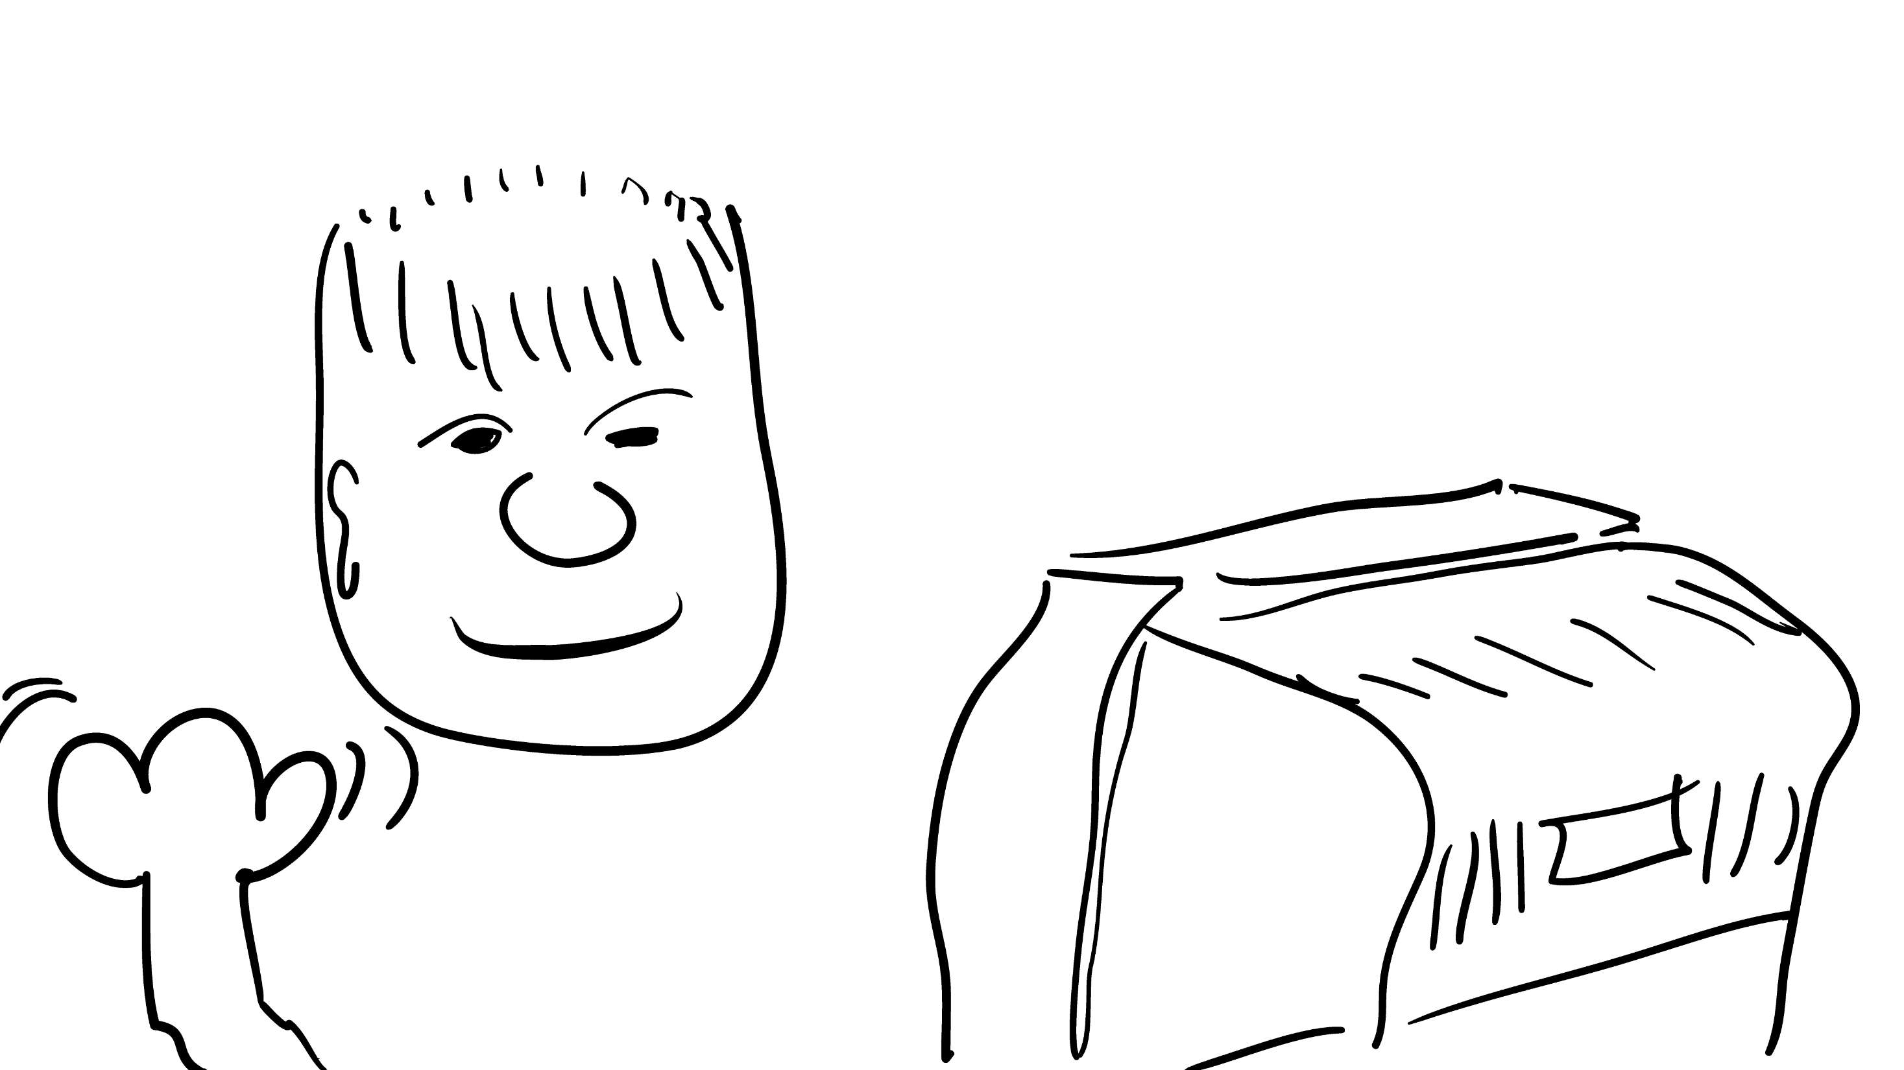
Notes:
I'd like to introduce Bob

Slide 28
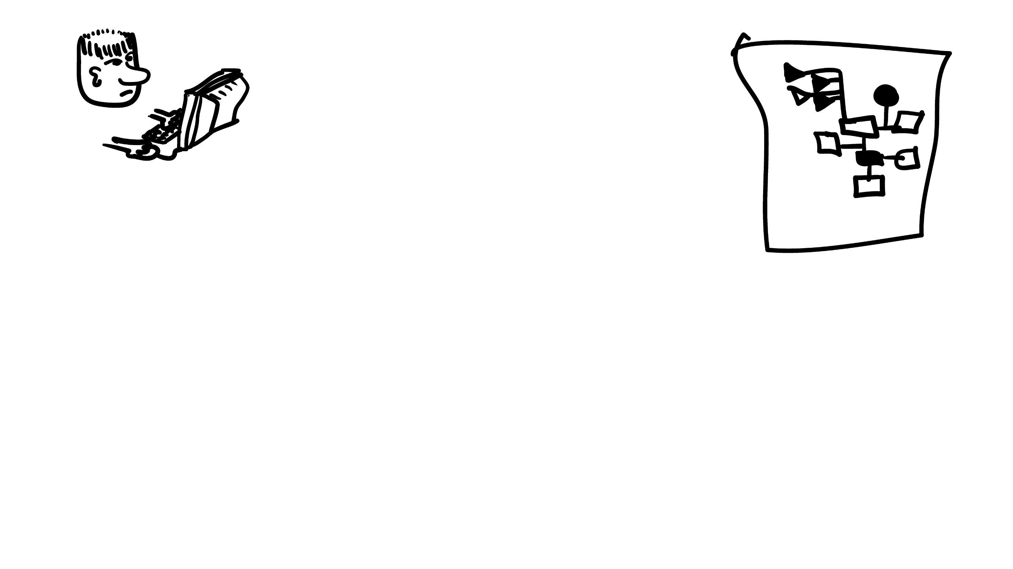
Notes:
Bob wants to query a bunch of complex data on a different computer

Slide 29
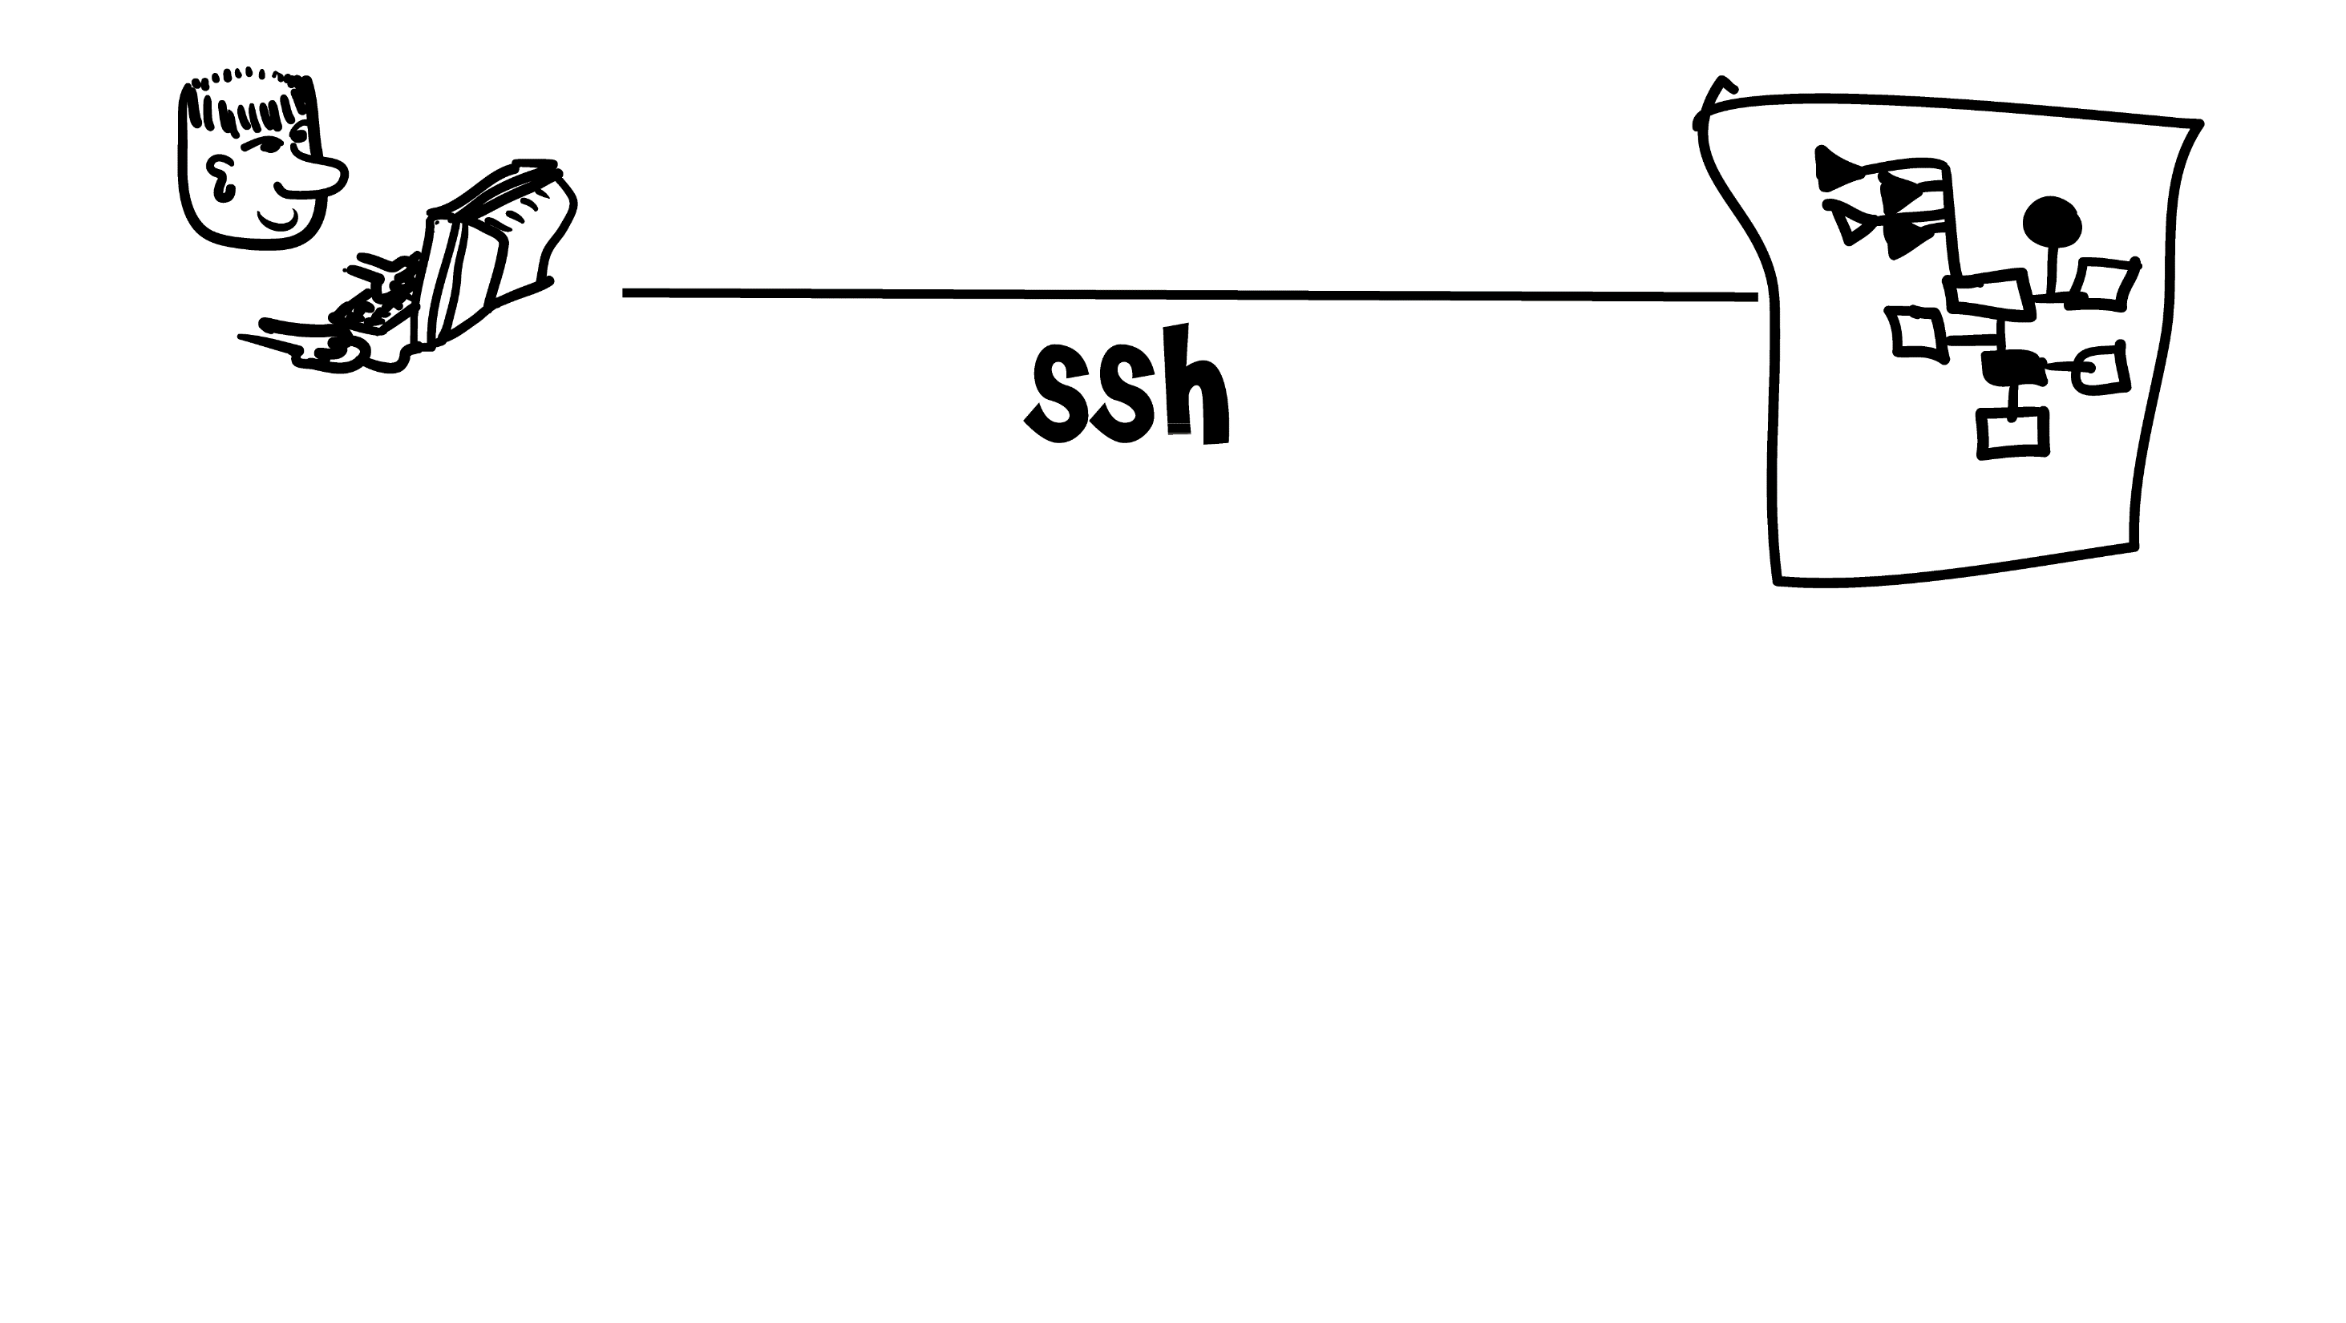
Notes:
Simpe. Give Bob a shell account, let him SSH in. No complex API - just let him have access with all his normal tools.

Slide 30
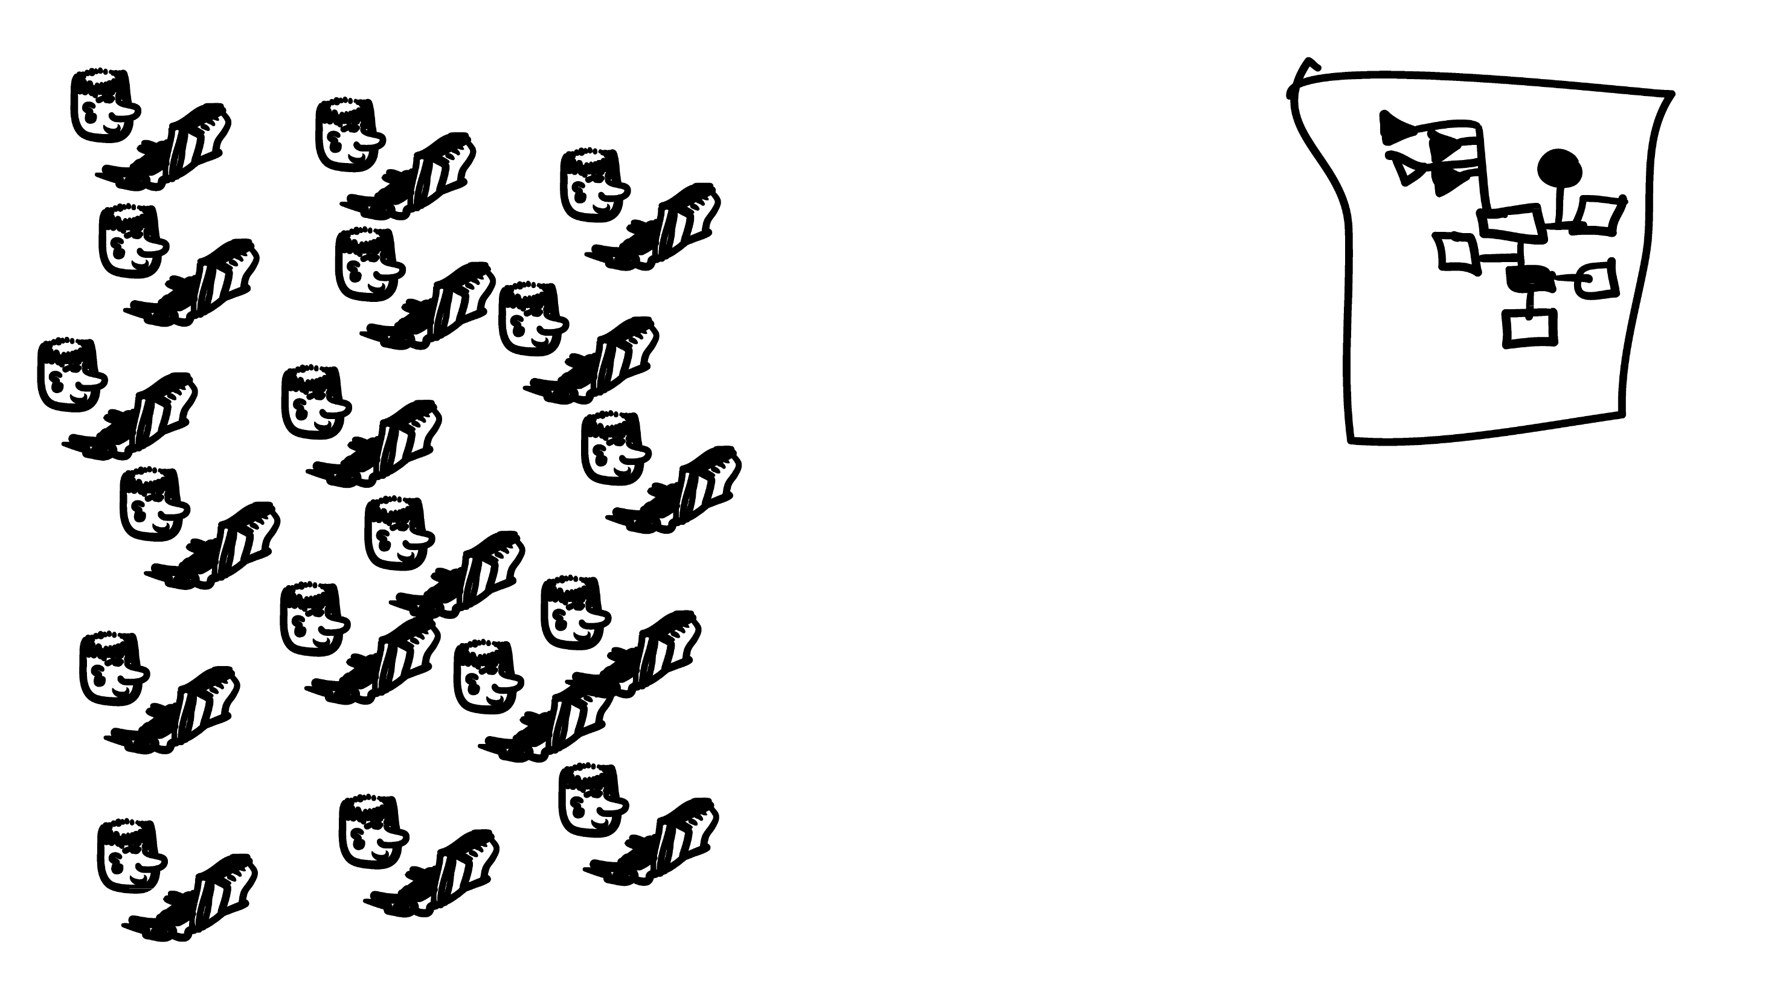
Notes:
This won't work at web scale, with millions of Bobs.

Slide 31
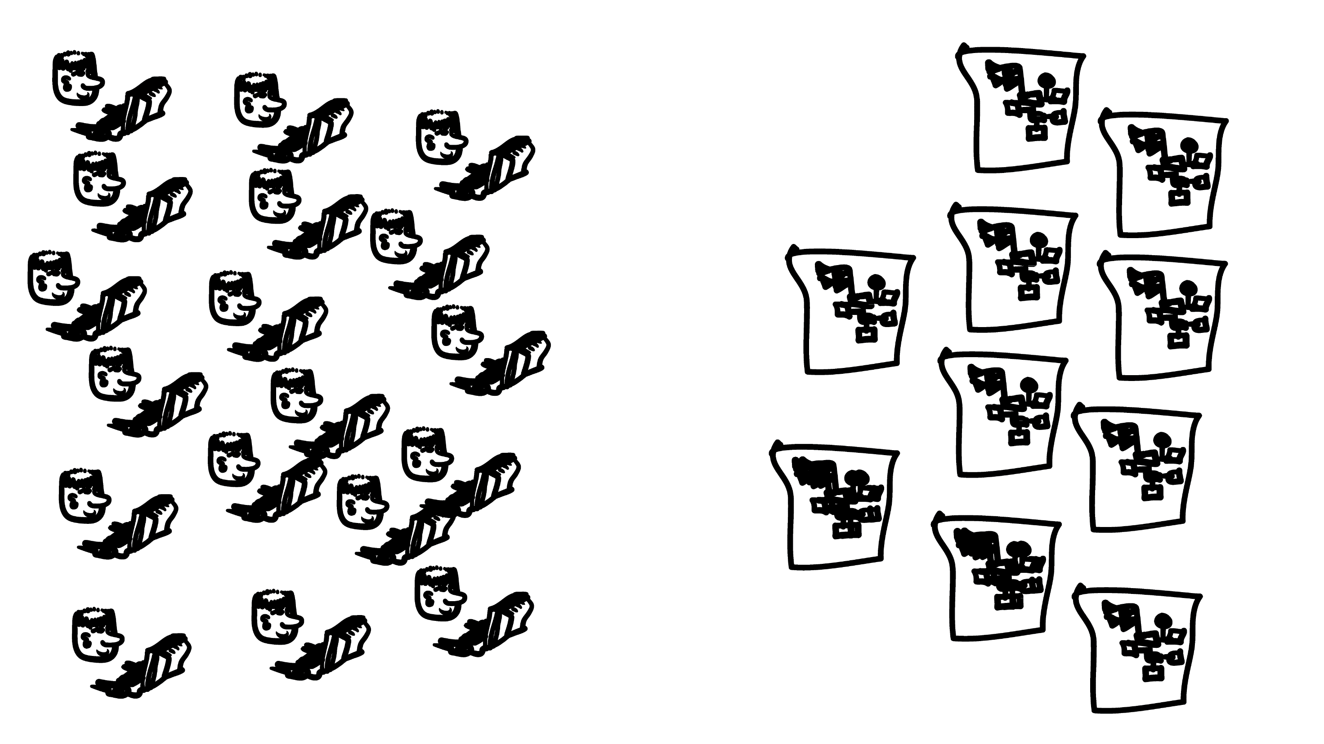
Notes:
and it gets worse if some of these bobs want to do queries that involve multiple servers

Slide 32
Notes:
And each server has a different API, so Bob has lots of programming to do, and can't make federated queries at all
By an federated query, I mean a query that requires joins on data from multiple servers.

Slide 33

Notes:
So how can we get back to this happy scenario?

Slide 34
Why Prolog?
Prolog's already suited to this sort of querying
SLD resolution matches the search you want -you can federate across servers
It's homoiconic, so you can easily send it over the internet
The WHEN clause in SPARQL already matches rdf/3 in Prolog
SWI-Prolog is already playing in the Semantic Web space
Cliopatria
RDF libraries
RDF persistancy
Notes:
Have examples, get away from read aloud slide
simple depth-first resolution strategy (SLD resolution). selective linear definite clause
Cut some of this, or work it in

Slide 35
Notes:
Bob's SSH client talks to the SSHD daemon, which talks to the shell, which talks to an application on the server. Bob types in commands, they run on the server. Effectively, Bob's running locally on the server.

Slide 36
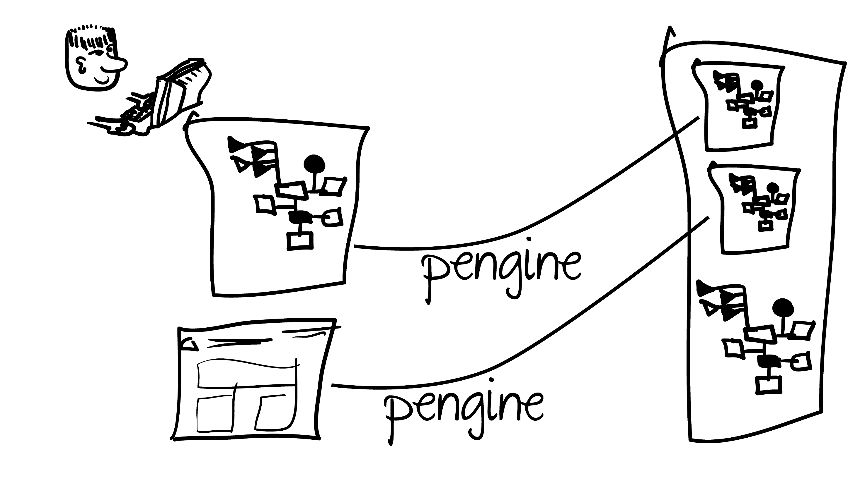
Notes:
Pengines work much the same way. The master server, (point) has access to a prolog shell on the remote machine (point).
A web page can also be the master. This simplifies web programming.

Slide 37
Notes:
The master can load code and execute prolog queries on the remote server.
Pengines lets Bob's code, or a page, obtain an ultra-lightweight VM and submit a nondeterministic query with the full power of the base Prolog language. EDIT ME
Instead of hand coding an URI endpoint for each API we need, we can provide a combinatorial set of building blocks, and let Bob combine them. Bob has the full power of Prolog available.

Slide 38
Notes:
concrete example here
Swish demo?

Slide 39
KB diagram

Slide 40
pengine architecture roles
Application
Master
Slave
Notes:
Application - container for pengine slaves
Master - creates pengines and queries them
Slave - private VM within an application

Slide 41
Pengine Architecture
Notes:
Diagram of Pengine network, showing all the possible masters and slaves

Slide 42
Query from Prolog

Slide 43
Query from Javascript

Slide 44
The Sandbox Application
whats safe?

Slide 45
Exposing API's in an application

Slide 46
Make your own application
do you get the safe libs in an own application?

Slide 47
Pengines atop the SWI-Prolog web framework is providing sufficient expressive power that we are already using it to build a new IDE for collaborative, distributed SWI-Prolog development.

Slide 48
pengines
Written by Torbjörn Lager this spring
Now the basis of a growing set of tools
SWI-Prolog web framework
pengines
SWISH
websockets
hub.pl
chat-demo
whiteboard
planned - Data browser
planned - online teaching system
planned - move the IDE
Notes:
Written by Torbjörn Lager this spring
Now the basis of a growing set of tools called SWISH
FIX ME READ ALONG

Slide 49
SWISH
online liteweight IDE
online data browser
Notes:
Demo application made with pengines

Slide 50
Where we're going
Fully web based, collaborative IDE
natural form editors
declarative javascript

